Slide 1
Statistical Programming in R
Srinivasa, Siddesh, Shetty & Sowmya

Slide 2
5: Iterative programming in R
Objectives
While and for loops
Loops for vectors, matrices, data frames, and lists

Slide 3
5.1 Introduction
Necessity of iterative statements
These include for and while loops

Slide 4
5.2 While Loop
The syntax for the while loop consists of test_expression that acts as the minimal condition for the loop to check how many times it has to be executed
while(test_expression){
statement
}

Slide 5
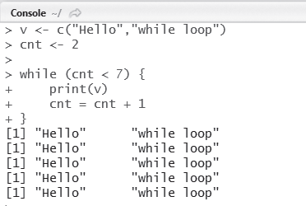
Example
Write an R program to print the values in vectors using the while loop.
Fig. 5.1 Hello world using while loop

Slide 6
5.3 For Loop
The syntax of for loop consists of variable that can be used inside the loop for iterating over the list of elements in a vector or a list.
for (variable in start:end){
statement
}

Slide 7
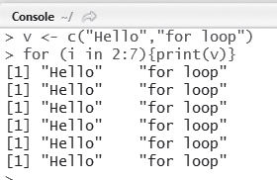
Example
Write an R program to print the values in vectors using the for loop.
Fig. 5.2 Hello world using for loop

Slide 8
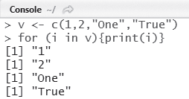
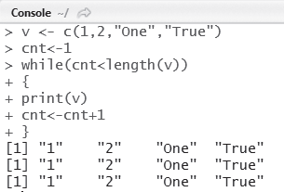
5.4 Looping Over List
L oops for Vectors
Fig. 5.3 Vectors using for loop
Fig. 5.4 Printing vectors using while loop

Slide 9
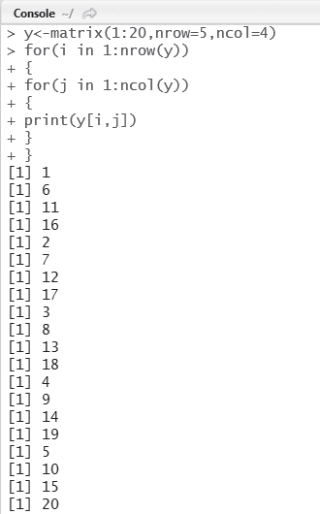
Loops for Matrices
A matrix can be created in R using the matrix() function
Fig. 5.5 Printing the elements of a matrix using for loop

Slide 10
L oops for Data Frames
A data frame in R consists of a group of vectors
It is created using the data.frame() function
Example
Write an R program to create four vectors namely patientid, age, diabetes, and status. Put these four vectors into a data frame patientdata and print the values using a for loop

Slide 11
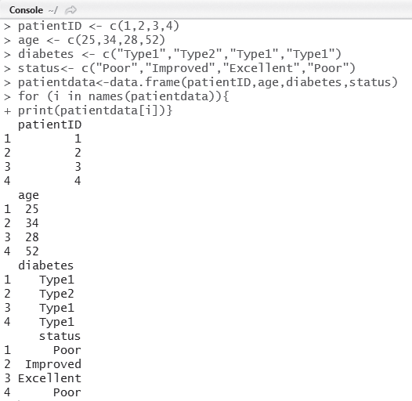
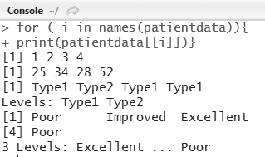
Listing the contents of data.frame()
Creation of data.frame()

Slide 12
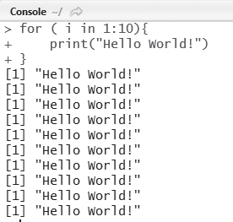
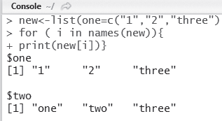
Loops for Lists
Write an R program to print HELLO 10 times using the for loop.
Creation of list()
Printing HELLO 10 times

